Slide 1
Lecture 14

Slide 2
Lecture 14 objectives
Understand the MM treatment of enzyme kinetics
Apply the MM constants to biological contexts

Slide 3


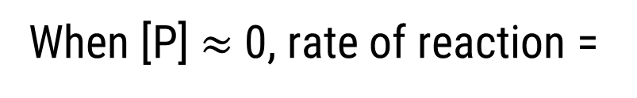
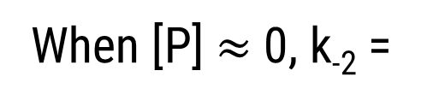
MM kinetics – a model for enzyme action
When [P] $≈$0, k₋₂ =
0
When [P] $≈$0, rate of reaction =

Slide 4
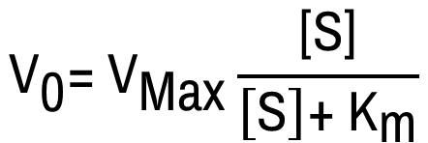
MM kinetics – a model for enzyme action
What are the major assumptions to derive this?

Slide 5
MM kinetics – a model for enzyme action
B
C
[Product]
A
Time
At given [E] and give [S],which describes v₀?

Slide 6
MM kinetics – a model for enzyme action
B
C
[Product]
A
Time
At given [E] and give [S],which describes ΔG = 0?

Slide 7
MM kinetics – a model for enzyme action
B
C
[Product]
A
Time
MM assumptions are satisfied only at what point in the graph?

Slide 8
MM kinetics – a model for enzyme action
A
[Product]
B
C
Time
At give [E], which line occurs when I increase [S]?

Slide 9
MM kinetics – a model for enzyme action
[Product]
Time
Measure v₀ at different [S]. Plot v₀ VS [S]

Slide 10
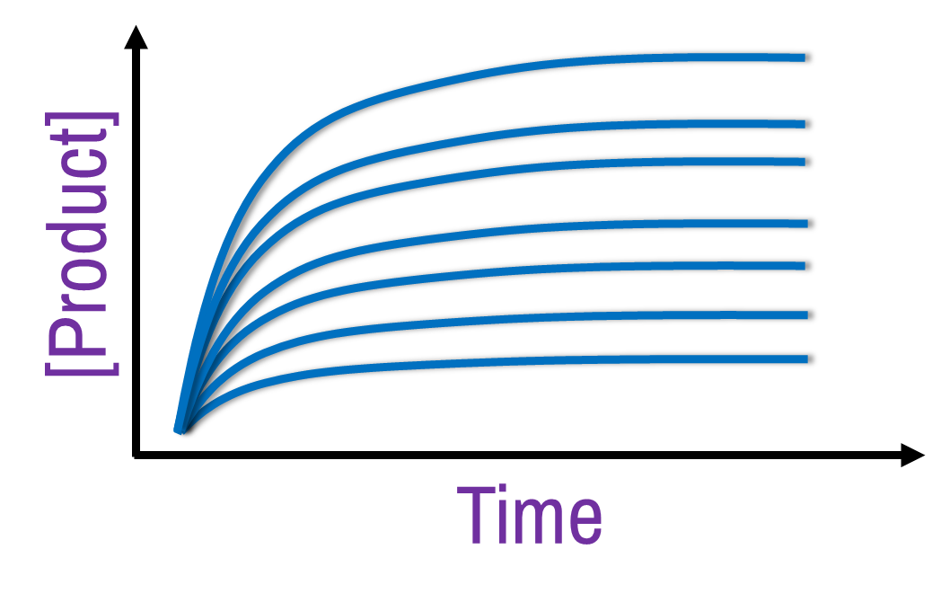

MM kinetics – a model for enzyme action
Measure v₀ at different [S]. Plot v₀ VS [S]
A
B
v₀
v₀
[S]
[S]
C
D
v₀
v₀
[S]
[S]

Slide 11
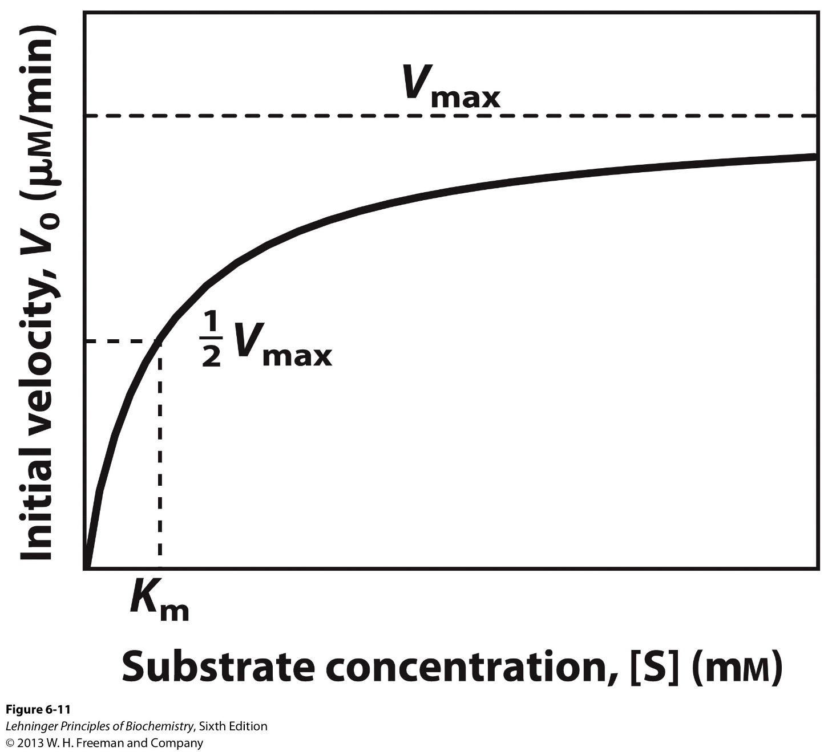
The Michaelis-Menten kinetics graph

Slide 12
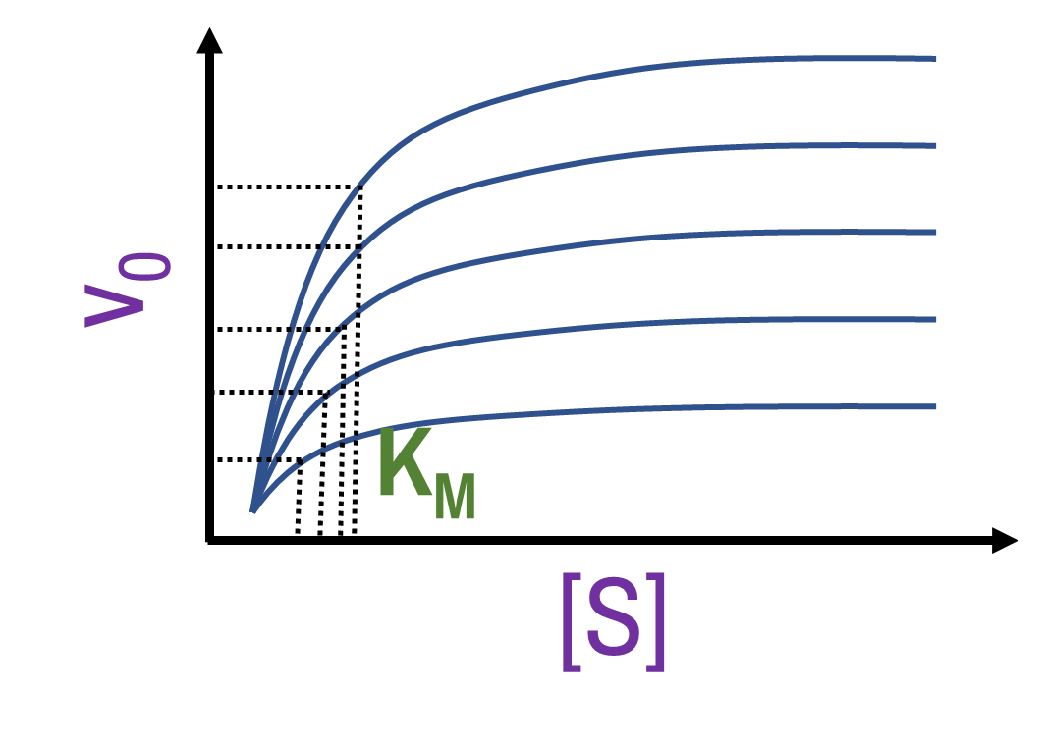
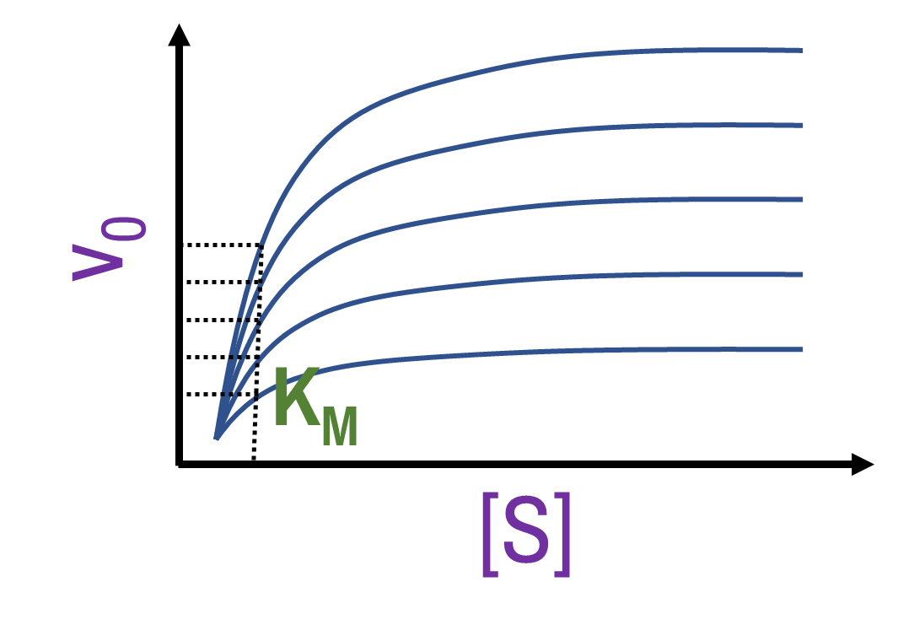
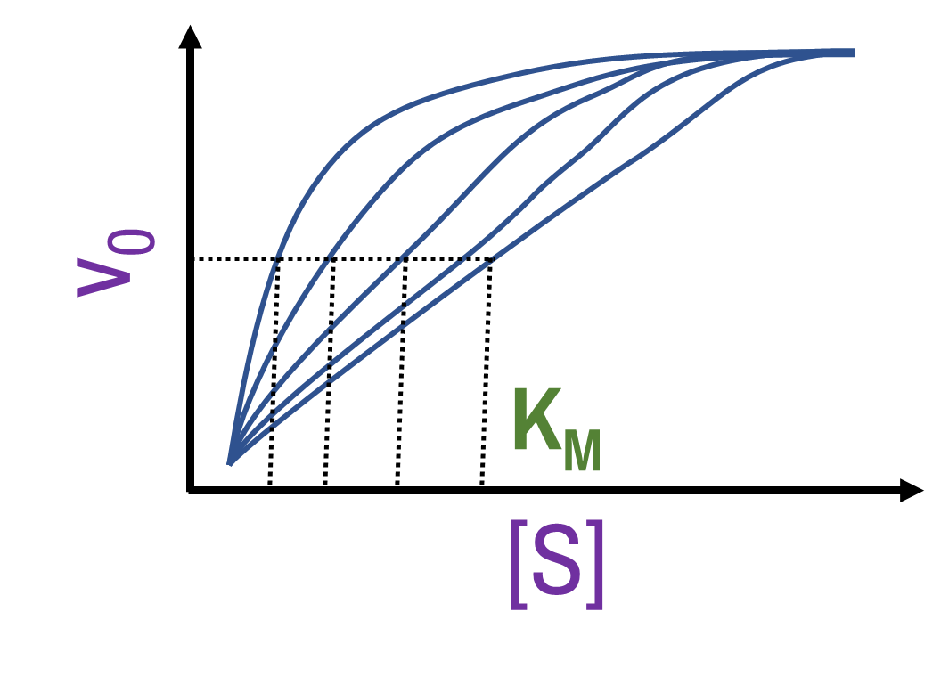
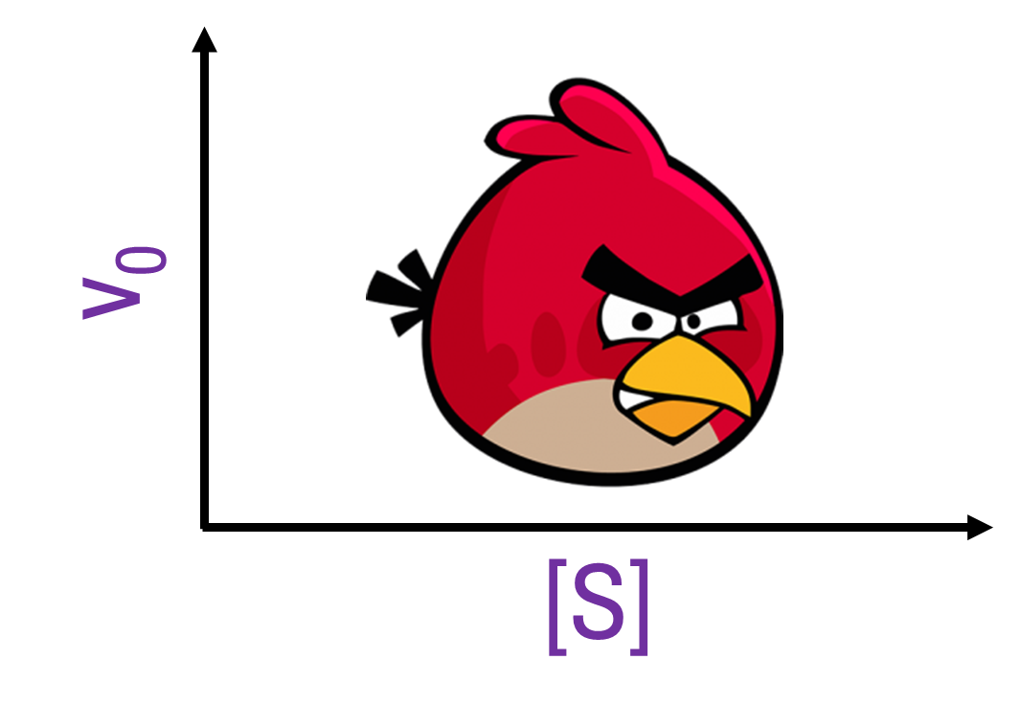
MM kinetics – a model for enzyme action
Increasing [E]. What happens to the MM graph?
A
B
C
D

Slide 13

V_{max} VS Turnover number
V_{max} depends on [E] –
Instead, use k₂ →
Once you have ES,
Eg: k₂ = 1000 molecules sec⁻¹
Alternatively, reciprocal ($\frac{1}{k_{2}}$) gives us…
V_{max} →

Slide 14
V_{max}… practical considerations…
D
B
C
A
v₀
[S]
Which is best estimate of V_{max}?

Slide 15


How to estimate V_{Max}?
y = mx + c

Slide 16
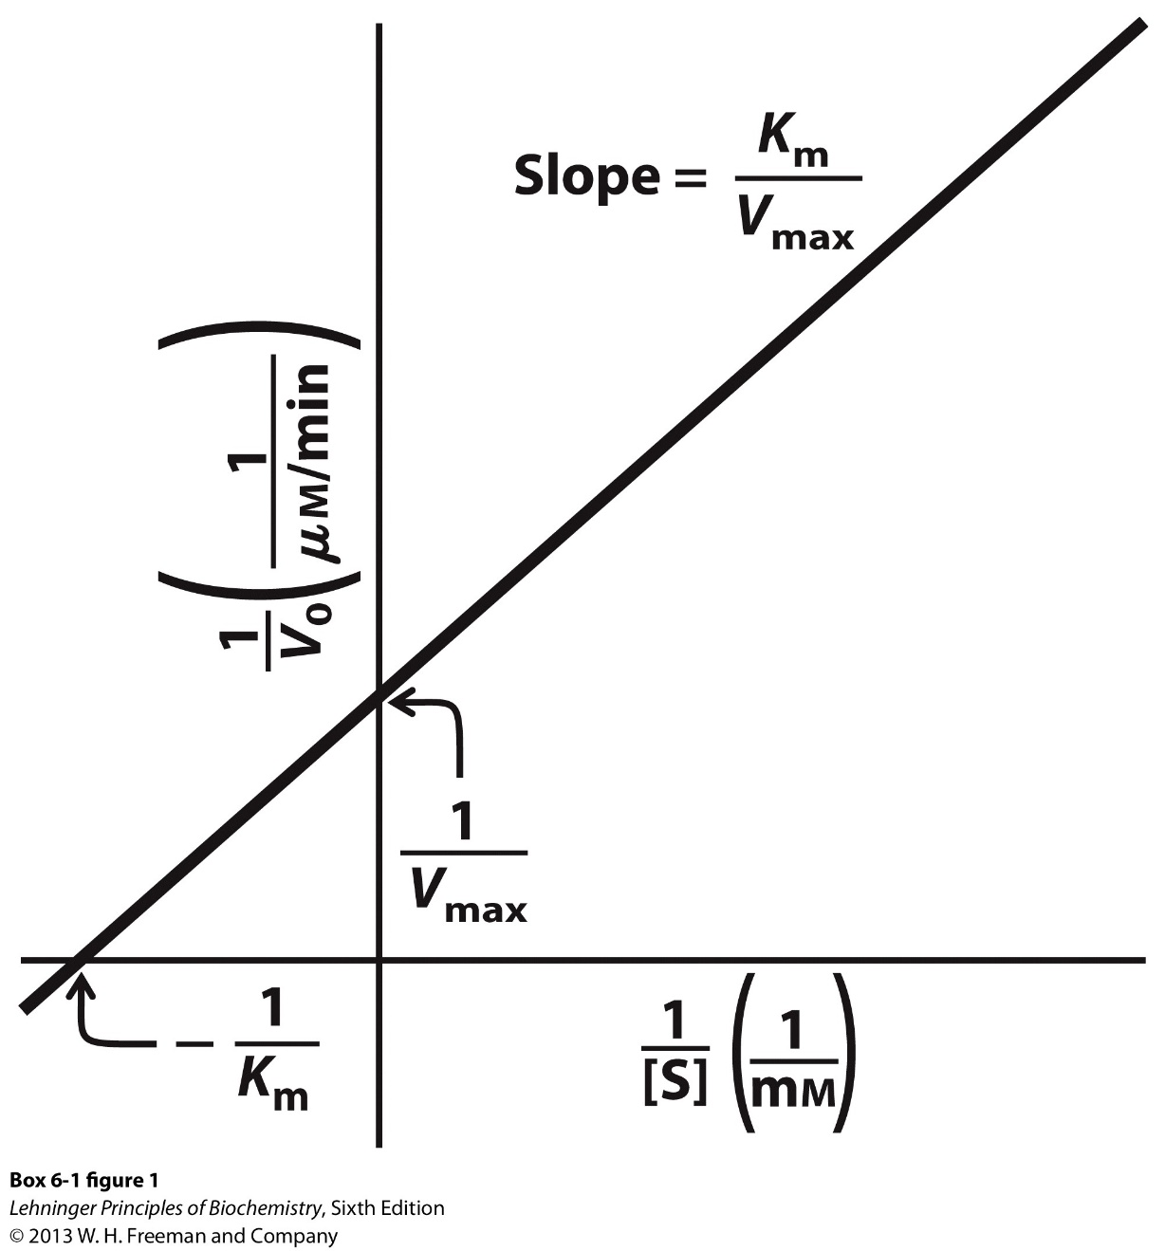
The Lineweaver-Burk plot

Slide 17


K_{m}, V_{max}, V₀ – Biological relevance?
Parameters for enzyme action
Rates and regulation!

Slide 18
The importance of V_{max}
Two isozymes for Glc → Glc-6-PO₄. Hexokinase_{A} = high V_{max}; Hexokinase_{B} = low V_{max} Which might be in muscles?
A. Hexokinase_{A}; need more energy in muscles
B. Hexokinase_{B}; need to conserve Glc in muscles
C. Hexokinase_{A}; need more enzyme in muscles
D. Are the muscles working?

Slide 19
K_{m}
[S] at which rate is ½ of V_{Max}
NOT ½ V_{Max}!
AFFINITY of enzyme for substrate
High K_{m} =
LOW affinity

Slide 20
K_{M} and metabolism
LIVER
Fat
Glc
Glc
Regulate levels
Fats
First step in Glc metabolism: Hexokinase. Compare liver and adipose hexokinase K_{m}s…
A. Adipose > Liver
C. Both are similar
B. Liver > Adipose
D. I don’t eat glucose – I don’t care

Slide 21
MM kinetics – a model for enzyme action
v₀
[E]
Blue line = WT; Red = mutant.

Slide 22
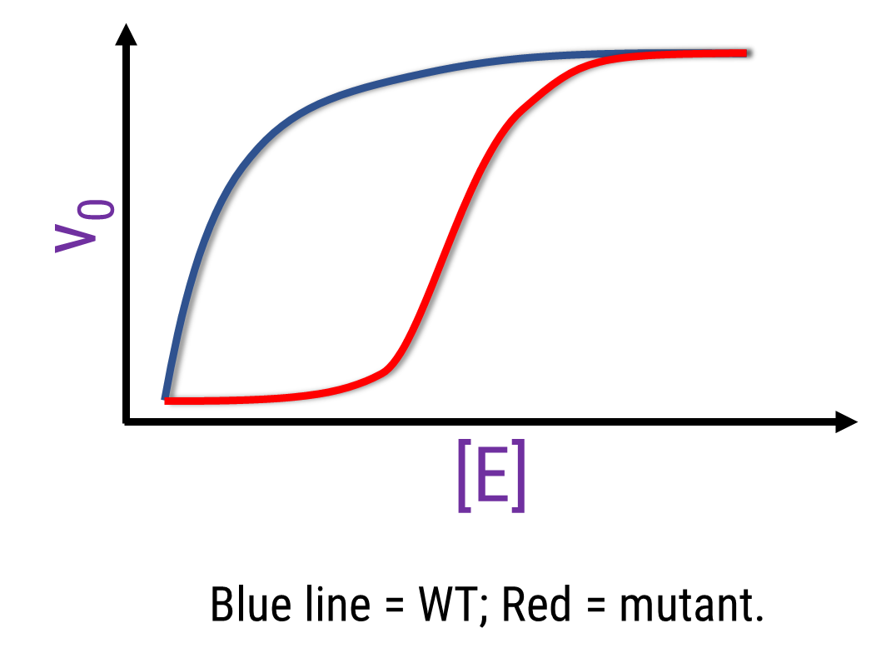
MM kinetics – a model for enzyme action
Which enzyme displays MM kinetics?
A. Both
B. WT
C. Mutant
D. Neither

